Slide 1
Can you match the title to the novelist?
You can do this ‘blind’ or with a little
help…
You decide…

Slide 2
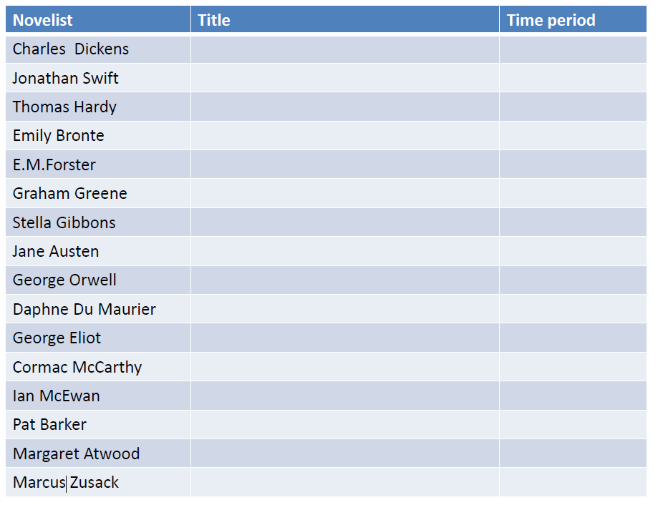

Slide 3
TITLES…
1. A Tale of Two Cities
2. 1984
3. Atonement
4. Gulliver’s Travels
5. A Room with a View
6. The Handmaid’s Tale
7. The Book Thief
8. Tess of the D’urbervilles
9. Wuthering Heights
10. Cold Comfort Farm
11. The Road
12. The Mill on the Floss
13. Rebecca
14. Regeneration
15. Brighton Rock
16. Pride and Prejudice

Slide 4

Create a novelists’ timeline.
➢Use the novelists from the quiz.
➢Add in others you are familiar with across the time range.
➢Include pictures and titles of works as well as dates for each writer
➢You can create your timeline either in a digital format on word or PowerPoint or as a paper copy.

Slide 5

You may find the following link useful to help you in your research from the British Library.
➢www.bl.uk/learning/langlit/evolvingenglish/accessvers/
➢E-mail your completed timelines either as a digital copy or as picture attachment to:
➢rachel.sammons@shaftesburyschool.co.uk
➢Deadline Thursday 30th April

