Slide 1
Year 11 A-Level
Task 5: Watching plays
Date due: September 4th

Slide 2
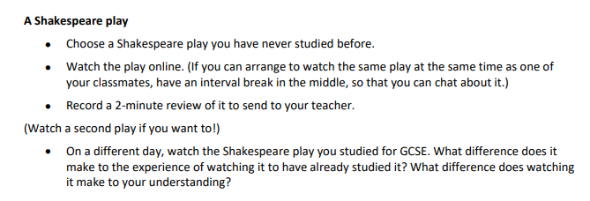
First task: watching Shakespeare plays online instead of recording the review you can write it instead.

Slide 3
Links to watching Shakespeare plays on-line
https://www.bbc.co.uk/iplayer/episode/m001lzzm/the-tragedy-of-macbeth
https://www.bbc.co.uk/iplayer/episode/m001gzsb/twelfth-night-from-shakespeares-globe
https://www.bbc.co.uk/iplayer/episode/b07dx7lt/a-midsummer-nights-dream
https://online.clickview.co.uk/libraries/categories/14026522/videos/32706908/othello-royal-shakespeare-company

Slide 4
Task 2: Watching a play which is not Shakespeare
https://www.bbc.co.uk/iplayer/episode/m001f6zy/the-soldiers-tale
https://www.bbc.co.uk/iplayer/episode/m001d7j0/four-quartets-starring-ralph-fiennes
https://online.clickview.co.uk/libraries/categories/14026522/videos/31882264/sitting-in-limbo
https://online.clickview.co.uk/libraries/categories/14026522/videos/14027185/king-charles-iii

Slide 5
Task 2: Watching a play which is not Shakespeare
Write the script for a podcast/online discussion between a critic and a director. The following links will give you support in how to write this
http://youtube.com/playlist?list=PLJgBmjHpqgs7citDojiasj-nMABL_DXku
https://podcasts.apple.com/gb/podcast/nt-talks/id486761654?mt=2
https://www.youtube.com/channel/UCjz6LNDQOWaCkQegAHxyo2g

Slide 6
Task 5: Watching plays
Send both tasks:
Your review of a Shakespeare play you have not watched or read and the podcast based on a non-Shakespeare play by Monday September 4th 2023.
Enjoy watching the plays!

